Slide 1
Sachetan: A crowd-source based personal safety application
Presented by
Ozayer Islam- 2013331062
&
Shadman Habib - 2013331026
Supervised by
Sheikh Nabil Mohammad
Assistant Professor, Department of CSE
Shahjalal University of Science & Technology

Slide 2
Introduction
Bangladesh is a country with lots of crime happening here and there and many of them are being hidden or ignored. Some of the crimes are
Mugging
Road-accident
Robbery
Sexual harassment
Theft

Slide 3
Goal of our Thesis
Applying technology and data science –
Find the different patterns of these crimes in Bangladesh
Try to determine the movements of these incidents
Prevent or Minimize the incident rate by taking proper steps of authority.

Slide 4
Some Previous Works
There are some existing works related to this theme. Among of them –
Protibadi
Safe Street
Hollaback
Etc. are notable.

Slide 5
Limitations
Focus on sexual harassment or street harassment only
Just an application and do not gather data
No further analysis on data
Dependent on only one data source or not based on data
No visualization of data
Right now they are not available.

Slide 6
Sachetan: The new solution
With the combination of these previous works, we have worked on a new solution: Sachetan.
It is an android based application
It uses data science
It collects data through crowdsourcing

Slide 7
More about Sachetan
Generates a heat map for the crimes in Sylhet.
Takes data from two sources
    News articles extracted from online newspaper
    Crowd-sourced data from general users
Gives users multiple routes to any destination with danger zones marked on them
Users can provide reports about those social incidents
Anonymous report submission from users

Slide 8
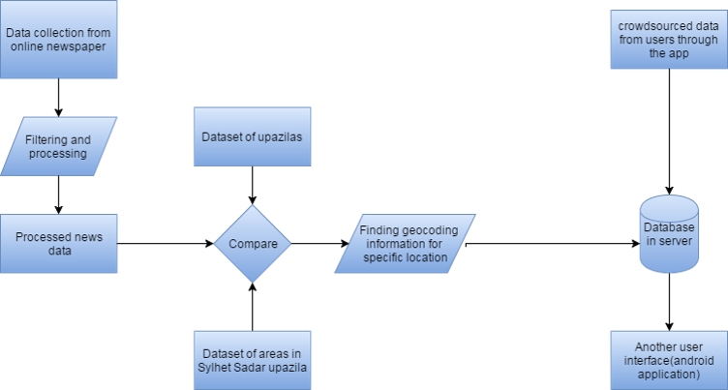
Architecture of the system

Slide 9
Crowdsourcing
What is crowdsourcing?
Crowdsourcing is the practice of obtaining information or input into a task or project by enlisting the services of a large number of people, either paid or unpaid, typically via the Internet.
We use crowdsourcing through our app.

Slide 10
Why crowdsourcing
To generate any crime patterns, we need enough data which is provided by crowdsourcing
All the news of incidents are not found in online newspaper, we chose crowdsourcing for our data source.

Slide 11
App update
As our thesis is based on data analysis, for getting enough data we have to depend on our app by which we will get crowdsourced data.
For this, we had to make our app totally bug free with more features included and more acceptable to users.

Slide 12
App update
Bug Fixes:
Sign up and Login: Previously the app had problems while signing up new users with mobile screen size less than 4.5 inches or less.
-Several input fields with Submit button used to disappear in the screen.
-After signing up, the app should take the users to the app homepage, rather it took the users to the login page.

Slide 13
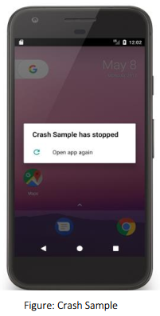
App update
Crashing: After restarting the app from minimization, the app used to crash and could not open.

Slide 14
App update
Server issue: The app is currently hosted at Amazon Web Service. But the extreme cost is making us think about other alternatives.
- We have considered about our University Server. But it is not efficient enough.

Slide 15
App update
Features:
Password Recovery: Previously there was no system for recovering password. Even verifying user email was absent. We have added these features in our app.
Alternate Path: The system now shows multiple routes with crime incidents marked on them, user can decide from the map which is appropriate for him in terms of time and safety.

Slide 16
Data Related Problems
There are some problems in the existing work --
The number of news that our crawler fetches is very low.
Duplicate data is not filtered properly in the existing system.
Extraction of some types of data such as Time, Date, Location etc. are not automated.
User data verification is not done.
Keyword matching algorithm should be more efficient.

Slide 17
Future Works
Collection of more data
More newspaper data crawling and efficient filtering
Cover all areas of Bangladesh
Detecting the false information from users
Adding SOS button
Notification on the phone
Various reporting Method
Automation of data extraction process
Further more research through data science to find new patterns or movements of the occurrences

